Slide 1
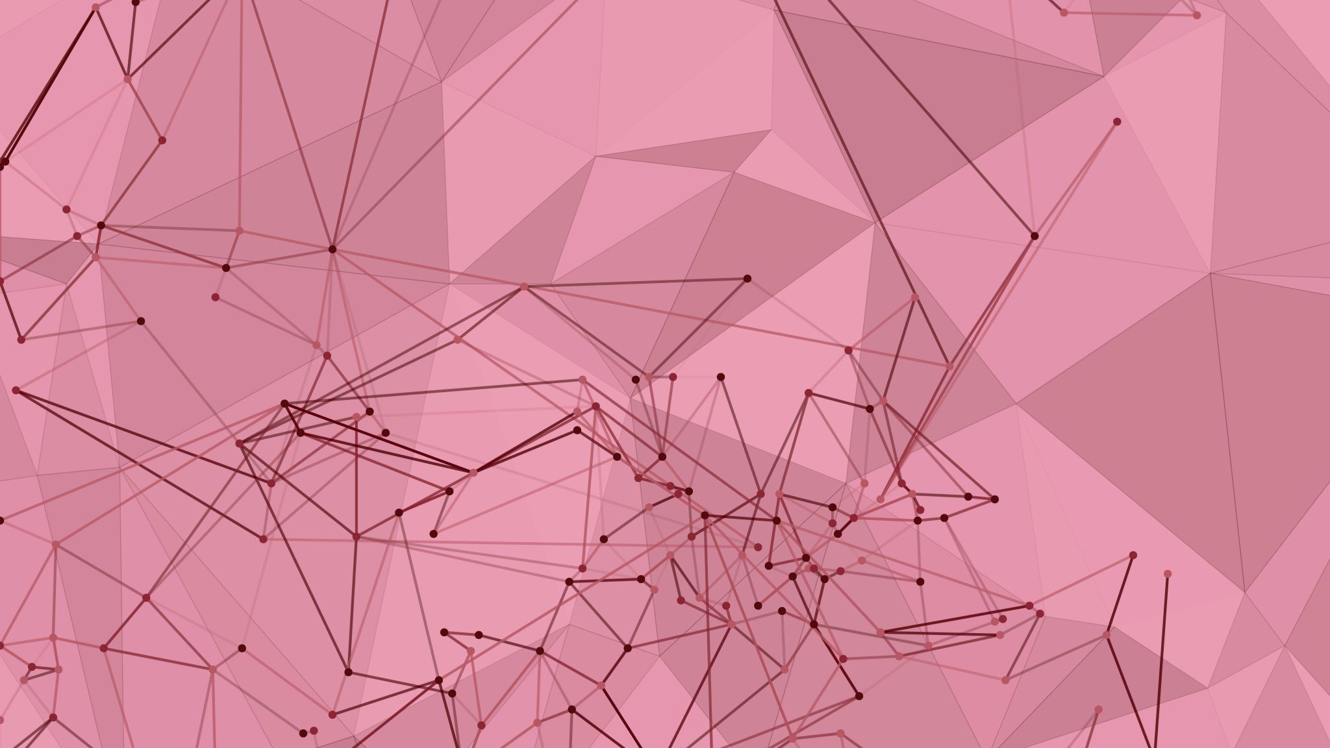
SCALABLE BIG DATA ANALYTICS PLATFORMS
UNIT 5

Slide 2
CONTENT
Cloud-based big data analytics platforms:
Amazon Web Services (AWS)
Microsoft Azure
Google Cloud Platform (GCP)
Containerization and orchestration tools:
Docker
Kubernetes
Big data deployment and scaling strategies,
Case studies and applications of big data analytics in various domains

Slide 3
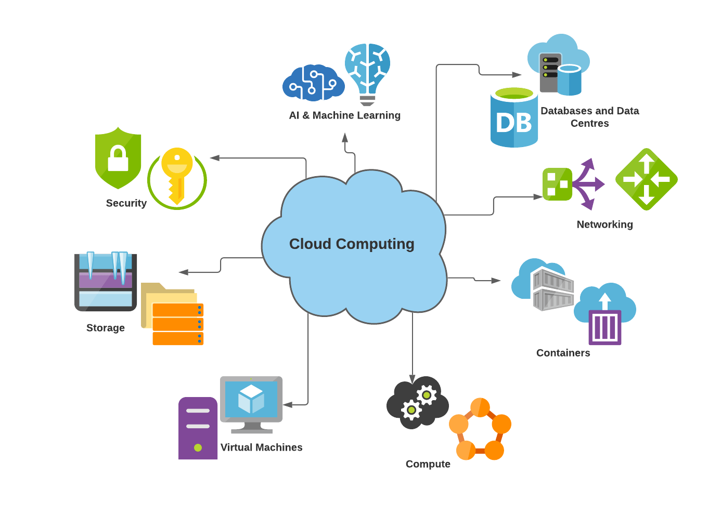
CLOUD COMPUTING

Slide 4
CLOUD COMPUTING
cloud computing is the delivery of computing services – servers, storage, databases, networking, software, analytics and more – over the Internet (“the cloud”).
Companies offering these computing services are called cloud providers and typically charge for cloud computing services based on usage, like how you’re billed for gas or electricity at home.

Slide 5
Cloud Computing Models, Resources, Attributes

Slide 6
Cloud computing - Characteristics
“Cloud Computing offers on-demand, scalable and elastic computing (and storage services).
The resources used for these services can be metered and users are charged only for the resources used.
Notes:
Difference between scalability and elasticity

Slide 7
Cloud computing (cont’d)
Shared Resources and Resource Management:
Cloud uses a shared pool of resources
Uses Internet techn. to offer scalable and elastic services.
The term “elastic computing” refers to the ability of dynamically and on-demand acquiring computing resources and supporting a variable workload.
Resources are metered and users are charged accordingly.
It is more cost-effective due to resource-multiplexing. Lower costs for the cloud service provider are past to the cloud users.
Data Storage:
Data is stored:
in the “cloud”, in certain cases closer to the site where it is used.
appears to the users as if stored in a location-independent manner.
The data storage strategy can increase reliability, as well as security, and can lower communication costs.
Management:
The maintenance and security are operated by service providers.
The service providers can operate more efficiently due to specialization and centralization.

Slide 8
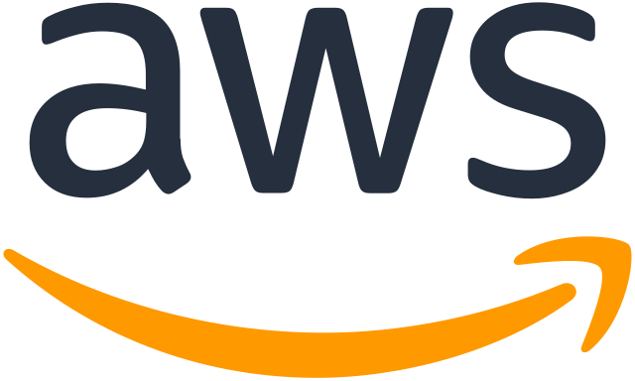

Slide 9
Amazon Web Services (AWS)
A comprehensive cloud computing platform provided by Amazon, offering a broad range of services for
Computing
Storage
Networking
Machine learning
Analytics
databases, and more
Launched in 2006, AWS provides on-demand cloud infrastructure and resources, allowing individuals, businesses, and organizations to access and scale IT infrastructure without the need for physical hardware or data centres.

Slide 10
Key Characteristics of AWS
On-Demand Resources:
AWS offers resources such as servers, databases, storage, and applications on a pay-as-you-go basis, meaning users only pay for what they use.
Scalability and Elasticity:
AWS can scale resources up or down based on demand, making it suitable for varying workloads, from small-scale startups to large enterprises.
Global Reach:
AWS has data centers worldwide, allowing users to deploy applications closer to their customers, improving latency and performance.
Comprehensive Service Offerings:
AWS provides over 200 fully featured services, covering areas such as computing, storage, databases, machine learning, analytics, IoT, security, and more.
Security and Compliance:
AWS prioritizes security with features like data encryption, identity and access management (IAM), and compliance with major regulatory standards (e.g., GDPR, HIPAA).

Slide 11
Amazon EMR
Easily run and scale Apache Spark, Hive, Presto, and other big data workloads
https://aws.amazon.com/emr/

Slide 12
AWS, Azure & GCP
S no | Feature/Aspect | AWS | Azure | GCP
1 | Provider | Amazon | Microsoft | Google
2 | Launch Year | 2006 | 2010 | 2008
3 | Global Market Share (2023) | Leading (around 32%) | 2nd largest (around 22%) | 3rd largest (around 10%)
4 | Compute Services | EC2 (Elastic Compute Cloud) | Virtual Machines (VMs) | Compute Engine
5 | Storage | S3 (Simple Storage Service), EBS | Blob Storage, Disk Storage | Cloud Storage, Persistent Disks
6 | Networking | VPC (Virtual Private Cloud) | Virtual Network | Virtual Private Cloud (VPC)
7 | Database Services | RDS, DynamoDB, Aurora, Redshift | SQL Database, Cosmos DB, MySQL | Cloud SQL, Bigtable, Firestore
8 | AI & Machine Learning | SageMaker, Lex, Polly, Deep Learning AMIs | Azure Machine Learning, Cognitive Services | AI Platform, TensorFlow, AutoML
9 | Big Data | EMR (Elastic MapReduce), Redshift | HDInsight, Synapse Analytics | BigQuery, Dataproc
10 | Serverless | Lambda | Azure Functions | Cloud Functions

Slide 13
AWS, Azure & GCP
S no | Feature/Aspect | AWS | Azure | GCP
11 | DevOps Tools | CodeBuild, CodeDeploy, CodePipeline | Azure DevOps, GitHub Actions | Cloud Build, Cloud Source Repositories
12 | Containers | ECS, EKS (Elastic Kubernetes Service) | Azure Kubernetes Service (AKS) | Google Kubernetes Engine (GKE)
13 | Hybrid Cloud | Outposts, VMware Cloud on AWS | Azure Arc, Azure Stack | Anthos
14 | Pricing Model | Pay-as-you-go, Reserved Instances, Spot Instances | Pay-as-you-go, Reserved Instances, Hybrid Benefit | Pay-as-you-go, Sustained use discounts
15 | Compliance & Security | Extensive certifications, IAM, KMS | Extensive certifications, Azure Active Directory | Extensive certifications, IAM, KMS
16 | Enterprise Adoption | Widely adopted across industries | Strong presence in enterprises (Microsoft ecosystem) | Strong in AI/ML and data-heavy industries
17 | Developer Ecosystem | Large community, extensive documentation | Strong integration with Microsoft tools | Strong community with a focus on data science
18 | Free Tier | 12-month free tier, always free offers | 12-month free tier, always free offers | 12-month free tier, always free offers
19 | Hybrid Cloud Focus | Limited compared to Azure | Strong focus with Azure Stack | Strong focus with Anthos
20 | Customer Support | 24/7 support with various plans | 24/7 support with various plans | 24/7 support with various plans

Slide 14
Containerization
The process of packaging an application and all its dependencies into a single, lightweight, executable unit called a container.
Containers are self-contained and run consistently across different environments, making them portable and efficient.
A container includes the application code, runtime, libraries, environment variables, and configuration files necessary to run the application.
Unlike virtual machines (VMs), containers share the host operating system's kernel, making them faster to start and more resource-efficient.

Slide 15
Benefits of Containerization
Portability:
Containers run the same way across different environments (developer laptops, on-premises servers, or cloud).
Consistency:
Containers ensure that applications run with the same configurations and dependencies, reducing "it works on my machine" issues.
Efficiency:
Containers share resources and start up quickly, making them more lightweight and cost-effective than traditional VMs.
Isolation:
Each container operates in its own isolated environment, allowing multiple applications to run on the same machine without conflicts.
Example
Docker is a popular tool for containerization, allowing developers to build and deploy containers consistently and efficiently.

Slide 16
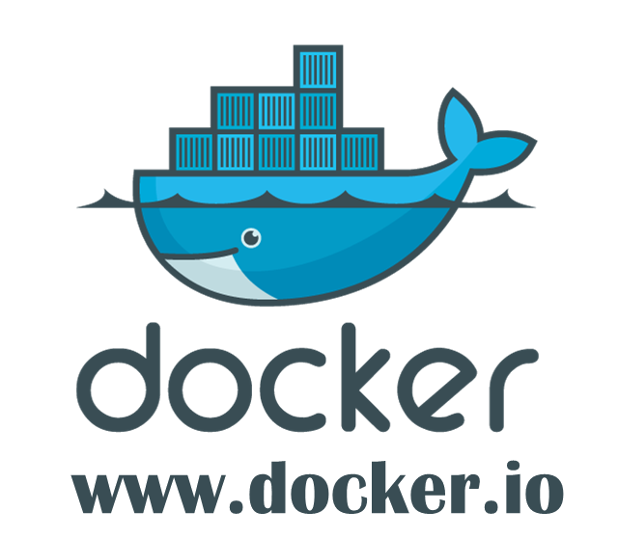
https://pointful.github.io/docker-intro/#/20

Slide 17
Since it started in March 2013...
200,000 pulls
7,500 github stars
200 significant contributors
200 projects built on top of docker
UIs, mini-PaaS, Remote Desktop...
1000’s of Dockerized applications
Memcached, Redis, Node.js, Hadoop...
Integration in Jenkins, Travis, Chef, Puppet, Vagrant and OpenStack
Meetups arranged around the world…
with organizations like Ebay, Cloudflare, Yandex, and Rackspace presenting on their use of Docker

Slide 18
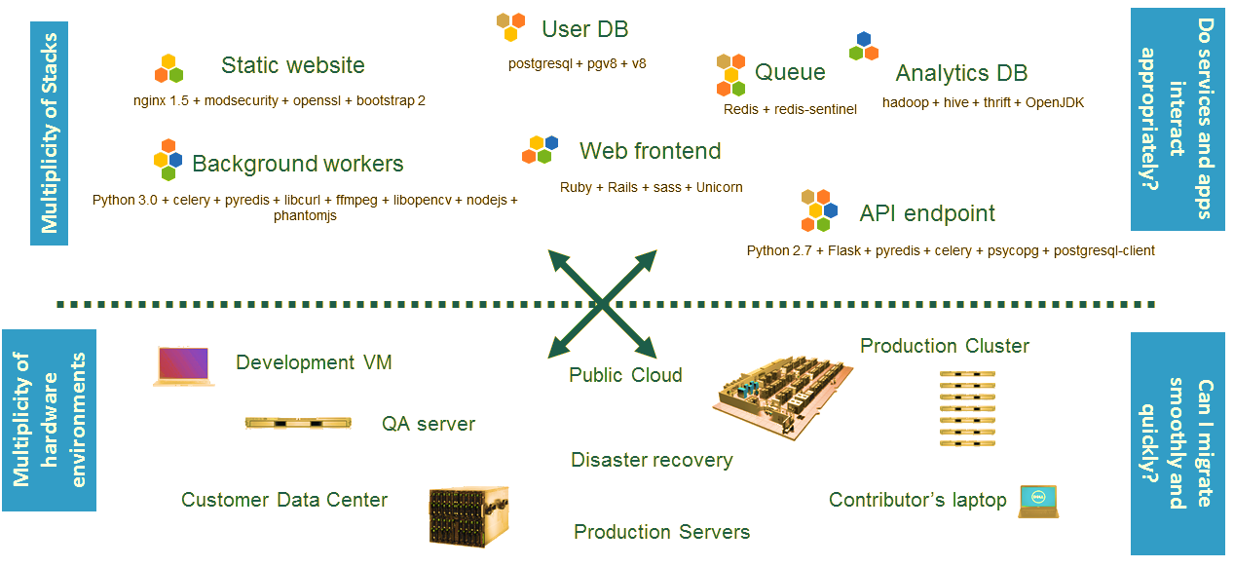
The Challenge

Slide 19
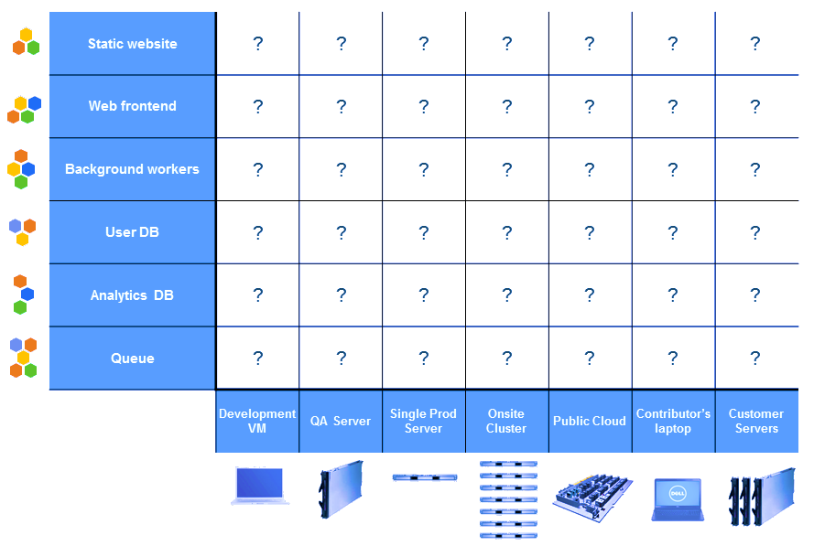
The Matrix from Hell

Slide 20
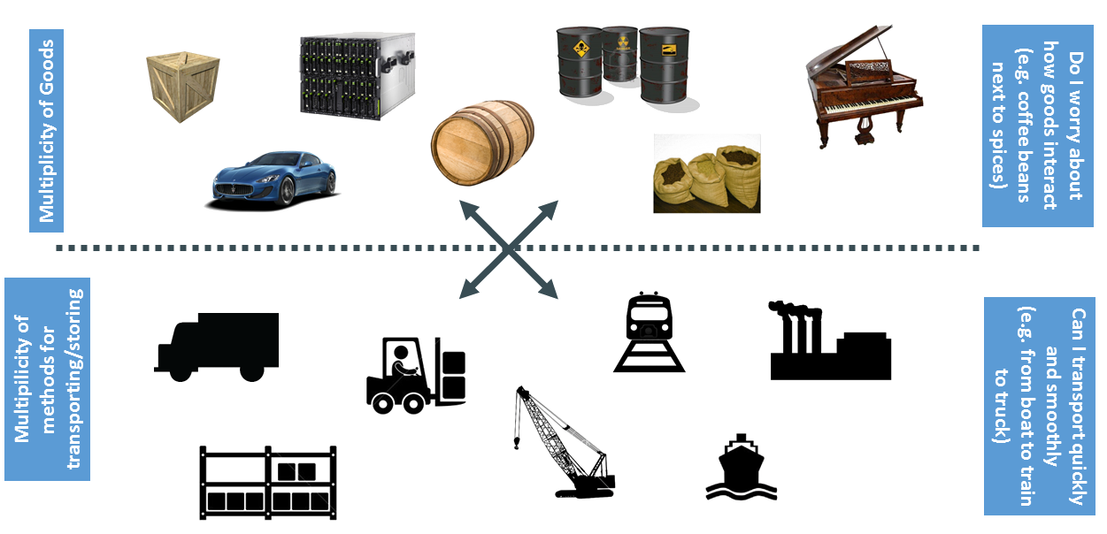
Let's create and analogy :Cargo Transport Pre-1960

Slide 21
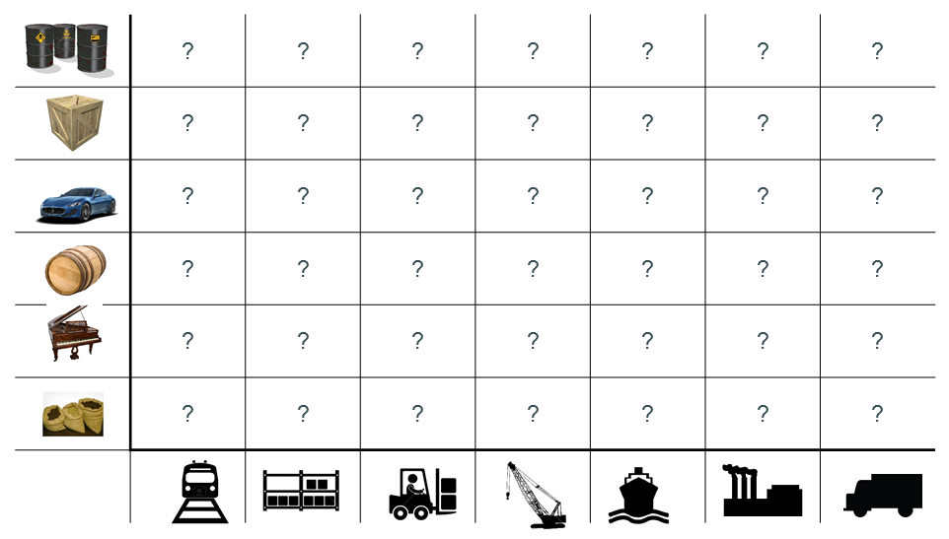
Also a Matrix from Hell

Slide 22
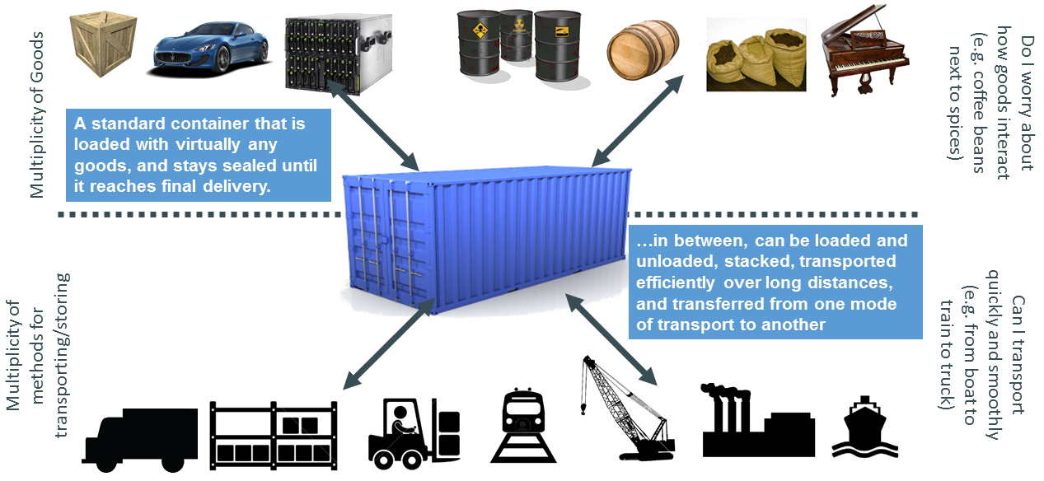
Solution: Intermodal Shipping Container

Slide 23
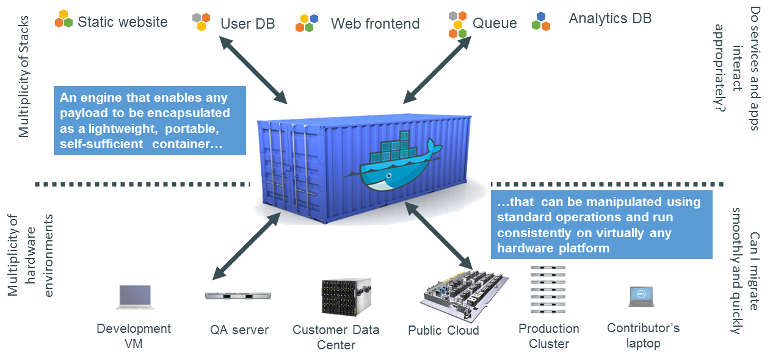
Docker is a Container System for Code

Slide 24
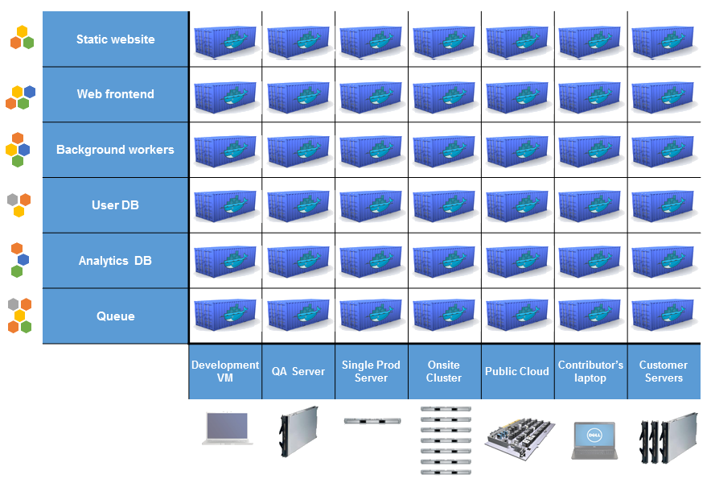
Docker Eliminates the Matrix from Hell

Slide 25
Why Developers Care
Build once... (finally) run anywhere
A clean, safe, hygienic, portable runtime environment for your app.
No worries about missing dependencies, packages and other pain points during subsequent deployments.
Run each app in its own isolated container, so you can run various versions of libraries and other dependencies for each app without worrying.
Automate testing, integration, packaging...anything you can script.
Reduce/eliminate concerns about compatibility on different platforms, either your own or your customers.
Cheap, zero-penalty containers to deploy services. A VM without the overhead of a VM. Instant replay and reset of image snapshots.

Slide 26
Why Administrators Care
Configure once... run anything
Make the entire lifecycle more efficient, consistent, and repeatable
Increase the quality of code produced by developers.
Eliminate inconsistencies between development, test, production, and customer environments.
Support segregation of duties.
Significantly improves the speed and reliability of continuous deployment and continuous integration systems.
Because the containers are so lightweight, address significant performance, costs, deployment, and portability issues normally associated with VMs.

Slide 27
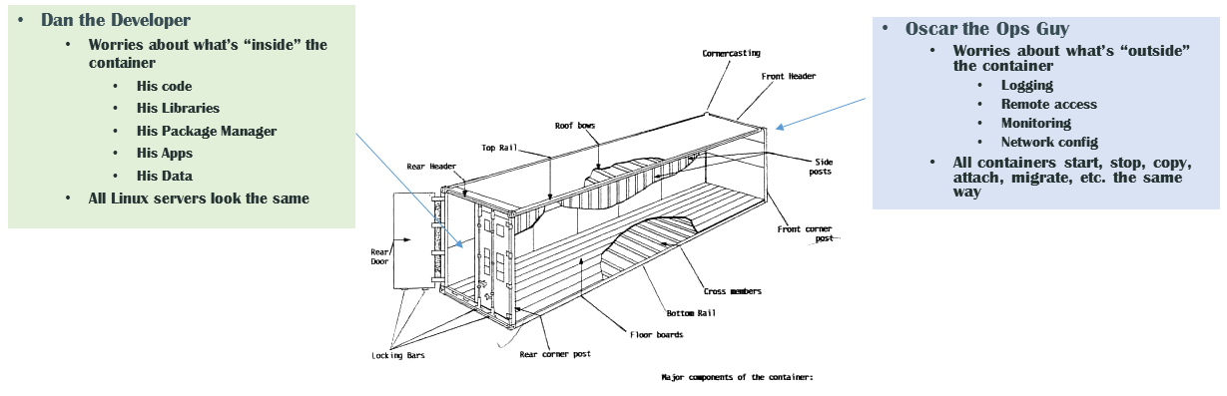
Why it Works: Separation of Concerns

Slide 28
More Technical Details
Why
What
Run everywhere
Regardless of kernel version
Regardless of host distro
Physical or virtual, cloud or not
Container and host architecture must match...
Run anythingIf it can run on the host, it can run in the container
If it can on a Linux kernel, it can run
High level: a lightweight VMOwn process space
Own network interface
Can run stuff as root
Can have its own /sbin/init (different from host)
<<machine container>>
Low level: chroot on steroidsCan also not have its own /sbin/init
Container = isolated processes
Share kernel with host
<="" li=""><<application container>>

Slide 29
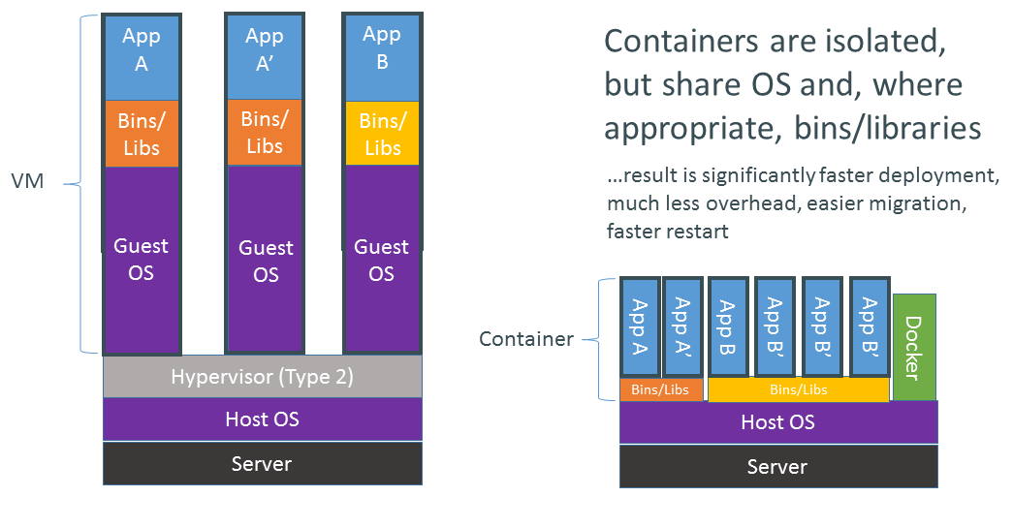
VMs vs Containers

Slide 30
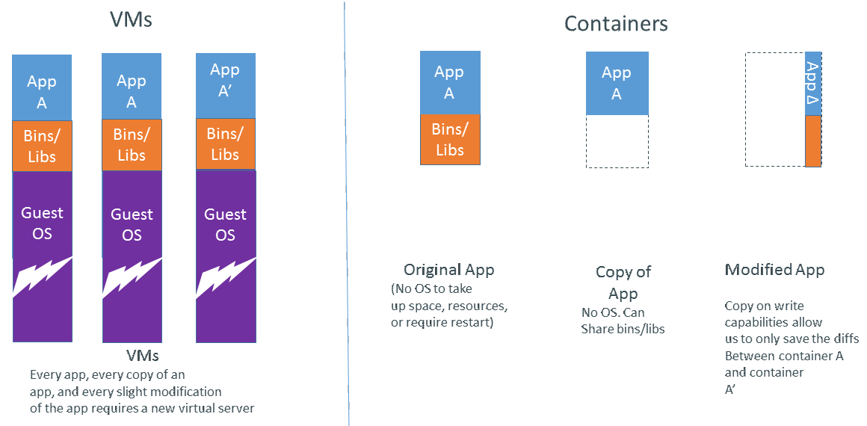
Why are Docker Containers Lightweight?

Slide 31
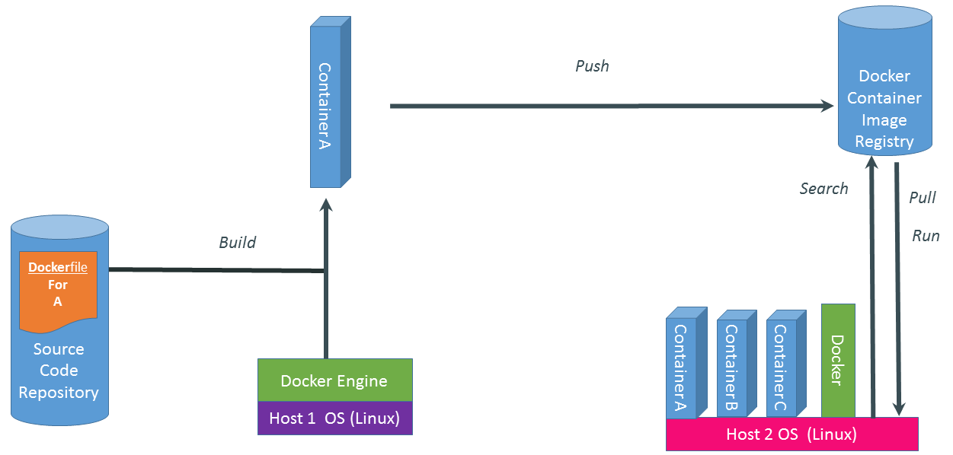
What are the Basics of a Docker System?

Slide 32
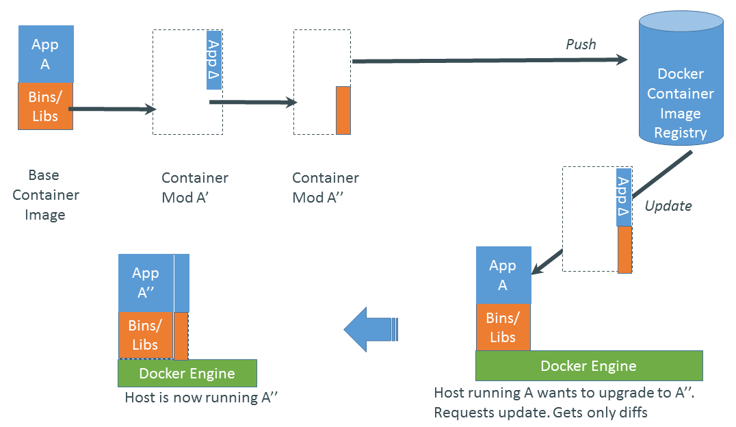
Changes and Updates

Slide 33
Ecosystem Support
Operating systems
Virtually any distribution with a 2.6.32+ kernel
Red Hat/Docker collaboration to make work across RHEL 6.4+, Fedora, and other members of the family (2.6.32 +)
CoreOS—Small core OS purpose built with Docker
OpenStack
Docker integration into NOVA (& compatibility with Glance, Horizon, etc.) accepted for Havana release
Private PaaS
OpenShift, Solum (Rackspace, OpenStack), Other TBA
Public PaaS
Deis, Voxoz, Cocaine (Yandex), Baidu PaaS

Slide 34
Ecosystem Support
Public IaaS
Native support in Rackspace, Digital Ocean,+++
AMI (or equivalent) available for AWS & other
DevOps Tools
Integrations with Chef, Puppet, Jenkins, Travis, Salt, Ansible +++
Orchestration tools
Mesos, Heat, ++
Shipyard & others purpose built for Docker
Applications
1000’s of Dockerized applications available at index.docker.io

Slide 35
Want to Learn More?
www.docker.io
Documentation
Getting started (tutorial, installation, guide, etc)
Introductory whitepaper
Github: dotcloud/docker
IRC: freenode #docker
Google Group: docker-user
Twitter: @docker
Meetups: www.docker.io/meetups

Slide 36
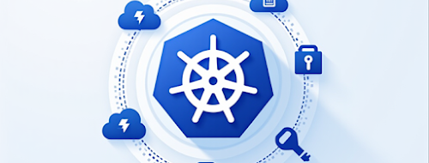
kubernetes

Slide 37
Introduction to kubernetes
Kubernetes, also known as k8s or kube, is an open-source container orchestration platform for scheduling and automating the deployment, management and scaling of containerized applications.
Today, Kubernetes and the broader ecosystem of container-related technologies have merged to form the building blocks of modern cloud infrastructure.
This ecosystem enables organizations to deliver a highly productive hybrid multicloud computing environment to perform complex tasks surrounding infrastructure and operations.
It also supports cloud-native development by enabling a build-once-and-deploy-anywhere approach to building applications.
The word Kubernetes originates from Greek, meaning helmsman or pilot, hence the helm in the Kubernetes logo (link resides outside of ibm.com).

Slide 38
Difference between docker and kubernetes
Aspect | Docker | Kubernetes
Purpose | A platform for building, packaging, and distributing containerized applications. | A container orchestration tool for managing, deploying, and scaling containerized applications.
Functionality | Provides tools to create, run, and manage individual containers. | Manages clusters of containers, ensuring high availability, load balancing, and scaling.
Focus | Focuses on containerization: packaging applications with all their dependencies. | Focuses on orchestration: scheduling, scaling, and managing containers in a distributed environment.
Core Component | Docker Engine (runtime) enables running containers. | Uses Docker (or other runtimes) to deploy and manage containers.
Deployment | Primarily for single-container applications or lightweight solutions. | Designed for managing multi-container applications and complex systems (e.g., microservices).
Scaling | Manual scaling of containers. | Automated scaling based on demand using predefined policies.
Networking | Limited networking for linking containers. | Advanced networking with service discovery, load balancing, and inter-container communication.

Slide 39
Difference between docker and kubernetes
Aspect | Docker | Kubernetes
Self-Healing | Does not provide automated container recovery. | Automatically restarts, replaces, or reschedules containers in case of failures.
Updates | Supports building and running updated containers manually. | Provides rolling updates and rollbacks without downtime.
Portability | Ensures applications run consistently across environments (local, cloud, etc.). | Extends portability to orchestrated clusters across hybrid and multi-cloud environments.
Ease of Use | Simple and developer-friendly. | Complex, requires expertise to configure and manage effectively.
Use Case | Suitable for small-scale containerized applications and local development. | Ideal for large-scale deployments, distributed systems, and production environments.
Relationship | Docker containers are used to package applications. | Kubernetes uses Docker (or other runtimes) to orchestrate and manage containers.
Can Be Used Independently | Yes, Docker can run containers without Kubernetes. | Yes, Kubernetes can work with other container runtimes (e.g., containerd, CRI-O).

Slide 40
What is Container Orchestration?
Container orchestration refers to the automated management of containerized workloads and services.
It addresses the challenges that arise when organizations deploy and manage hundreds or even thousands of containers.
It includes tasks like:
Scheduling container deployment.
Managing networking between containers.
Ensuring scalability, fault tolerance, and high availability.
Monitoring and maintaining the health of containerized applications.
Kubernetes has emerged as the industry standard for container orchestration.

Slide 41
History and Development of Kubernetes
Origins: Kubernetes is based on Borg, Google's internal container orchestration platform, which was developed to manage the company’s massive infrastructure.
Open Source Launch (2014): Google released Kubernetes as an open-source project, recognizing the need for an external, community-driven solution.
CNCF Partnership (2015): Google donated Kubernetes to the Cloud Native Computing Foundation (CNCF), a neutral body fostering cloud-native technologies.
Growth and Popularity:
Became the CNCF’s first hosted project in March 2016.
Graduated as CNCF’s first graduate project in 2018, a testament to its maturity and widespread adoption.
Currently, Kubernetes is the primary container orchestration tool for 71% of Fortune 100 companies.
Community Contributions:
The Kubernetes repository on GitHub has over 8,000 contributors and 123,000 commits.
It is the second-largest open-source project globally, after Linux.

Slide 42
Why Kubernetes Became Dominant
Vendor-Neutral and Open Source:
Supported by major tech companies like Microsoft, IBM, Red Hat, and Google.
Not tied to any single vendor, fostering broad adoption.
Scalability and Performance:
Handles large-scale deployments with thousands of containers.
Ecosystem Support:
Seamlessly integrates with other tools and platforms (e.g., Helm, Prometheus).
Backed by cloud providers like AWS, Azure, and Google Cloud.
Flexibility:
Supports hybrid and multi-cloud environments.
Can orchestrate various container runtimes beyond Docker, such as containerd and CRI-O.
Active Community:
Fast-paced development with frequent updates and robust support.
Feature-Rich:
Automates rolling updates, rollbacks, self-healing, and scaling.

Slide 43
Kubernetes vs. Other Orchestration Tools
Feature | Kubernetes | Docker Swarm | Apache Mesos
Scalability | Highly scalable for large clusters. | Suitable for smaller clusters. | Designed for massive scale but complex to manage.
Community Support | Strong global community and ecosystem. | Smaller community. | Limited adoption in modern container ecosystems.
Ease of Use | Complex setup but feature-rich. | Simpler to set up and use. | High learning curve.
Adoption | Widely adopted across industries. | Niche use cases. | Primarily used for legacy systems.

Slide 44
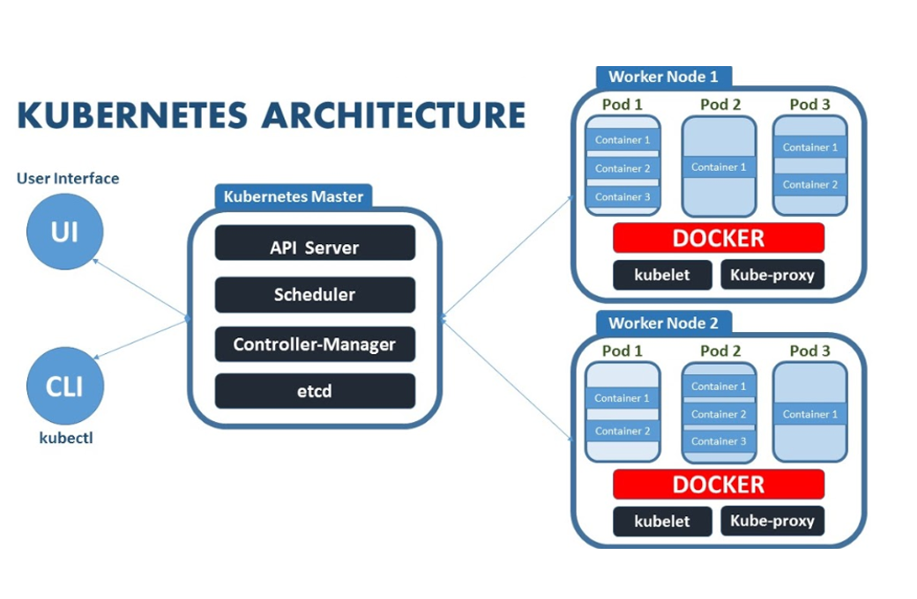
Kubernetes architecture and components

Slide 45
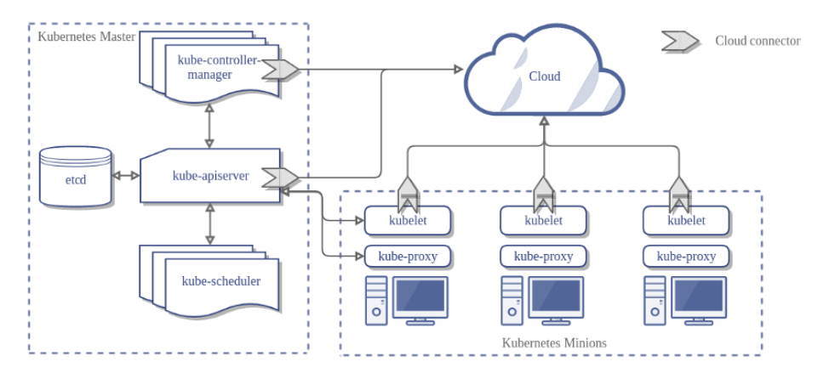
Kubernetes components

Slide 46
Cluster Overview
Cluster: The fundamental Kubernetes architecture unit, consisting of:
Master Node: Manages the cluster's control plane.
Worker Nodes: Execute the workloads by running containerized applications.
Pods: The smallest deployable unit, consisting of one or more containers that share resources like networking and storage.
Pods are the unit of scalability, replicated as needed across nodes.

Slide 47
Control Plane Components (Master Node) The control plane is the "brain" of Kubernetes, responsible for orchestrating the cluster.
Component | Function
API Server (kube-apiserver) | Exposes the Kubernetes API as an entry point for commands and queries, enabling communication between users, control plane components, and the cluster.
etcd | A distributed key-value store that manages cluster state, configuration data, and metadata, ensuring consistency across the cluster.
Scheduler | Assigns newly created pods to nodes by evaluating resource availability, hardware/software requirements, and constraints.
Controller Manager | Manages control loops to maintain desired states for resources like pods, service endpoints, and replica sets by interacting with the API server.
Cloud Controller Manager | Interfaces with the cloud provider to manage resources like load balancers, nodes, and storage in cloud environments.

Slide 48
Node Components (Worker Nodes) Worker nodes are responsible for running workloads and managing pods.
Component | Function
Kubelet | A node-level agent that ensures containers in pods are running as specified by the control plane.
Kube-proxy | Manages networking by maintaining network rules and load balancing between services and pods.

Slide 49
Other Kubernetes Concepts
Concept | Description
ReplicaSet | Ensures a specified number of pod replicas are running at any given time.
Deployment | Manages the lifecycle of applications, ensuring desired states and handling scaling and updates.
Kubectl | Command-line tool for managing clusters via the Kubernetes API.
DaemonSets | Ensures a specific pod is present on every node in the cluster.
Add-ons | Extend Kubernetes functionality, such as DNS for service discovery, web UI dashboards, and monitoring.
Service | Provides a stable network endpoint for accessing pods, enabling load balancing and service discovery.

Slide 50
Kubernetes Deployment Process
Developer creates a deployment using kubectl or another tool.
Deployment specifies the desired number of pods and configurations.
API Server processes the deployment and schedules pods via the Scheduler.
etcd stores the cluster's state.
Controller Manager ensures pods meet the desired state.
Kubelet runs the pods on the nodes, monitored by Kube-proxy for networking.

Slide 51

Kubernetes use cases
Microservices architecture or cloud-native development
Cloud native is a software development approach for building, deploying and managing cloud-based applications.
The major benefit of cloud-native is that it allows DevOps and other teams to code once and deploy on any cloud infrastructure from any cloud service provider.
This modern development process relies on microservices, an approach where a single application is composed of many loosely coupled and independently deployable smaller components or services, which are deployed in containers managed by Kubernetes.
Kubernetes helps ensure that each microservice has the resources it needs to run effectively while also minimizing the operational overhead associated with manually managing multiple containers.
Hybrid multicloud environments
Hybrid cloud combines and unifies public cloud, private cloud and on-premises data center infrastructure to create a single, flexible, cost-optimal IT infrastructure.
Today, hybrid cloud has merged with multicloud, public cloud services from more than one cloud vendor, to create a hybrid multicloud environment.
A hybrid multicloud approach creates greater flexibility and reduces an organization’s dependency on one vendor, preventing vendor lock-in. Since Kubernetes creates the foundation for cloud-native development, it’s key to hybrid multicloud adoption.

Slide 52
Kubernetes use cases
Applications at scale
Kubernetes supports large-scale cloud app deployment with autoscaling. This process allows applications to scale up or down, adjusting to demand changes automatically, with speed, efficiency and minimal downtime.
The elastic scalability of Kubernetes deployment means that resources can be added or removed based on changes in user traffic like flash sales on retail websites.
Application modernization
Kubernetes provides the modern cloud platform needed to support application modernization, migrating and transforming monolithic legacy applications into cloud applications built on microservices architecture.
DevOps practices
Automation is at the core of DevOps, which speeds the delivery of higher-quality software by combining and automating the work of software development and IT operations teams.
Kubernetes helps DevOps teams build and update apps rapidly by automating the configuration and deployment of applications.
Artificial intelligence (AI) and machine learning (ML)
The ML models and large language models (LLM) that support AI include components that would be difficult and time-consuming to manage separately.
By automating configuration, deployment and scalability across cloud environments, Kubernetes helps provide the agility and flexibility needed to train, test and deploy these complex models.
Kubernetes tutorials

